Slide 1
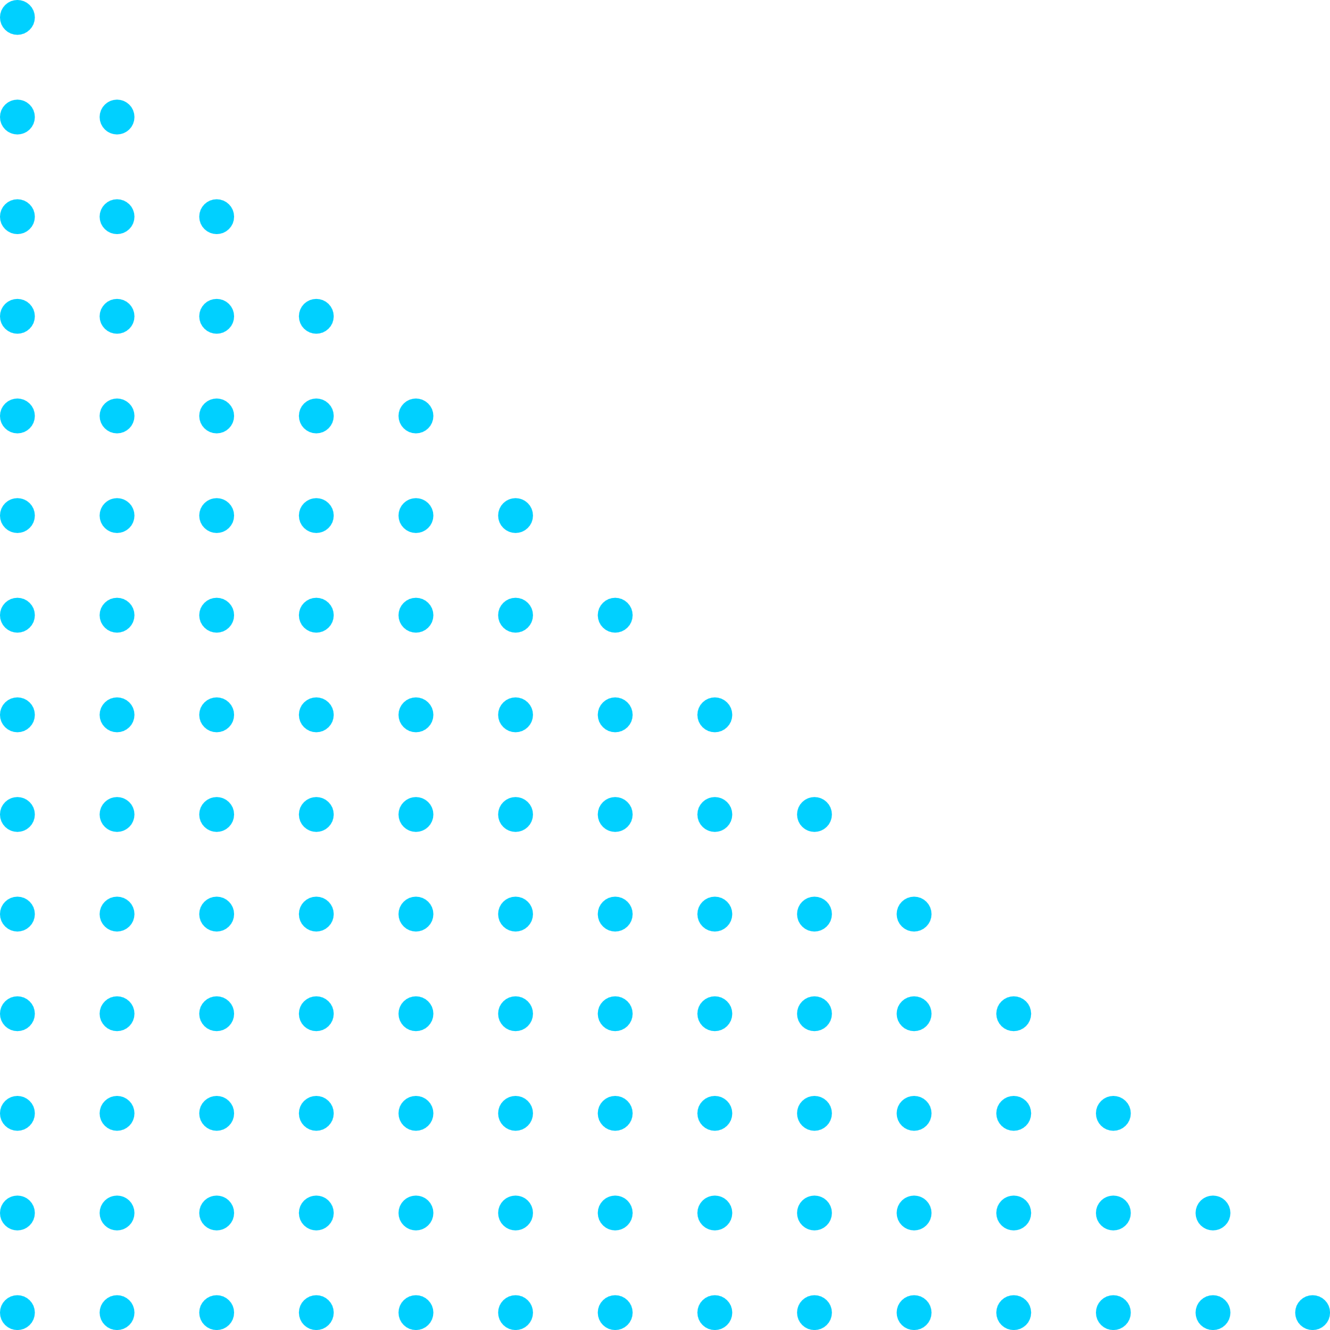

TEAM DETAILS
Team Name: Deadline Tech Team
Team Leader Name: G . Hema Naga Sri
College Name: Lakireddy Balireddy College of Engineering
Team Member 1 Name : A. Bhargavi
Team Member 2 Name : M. Vagdevi
Team Member 3 Name : J. Harika

Slide 2
APPROACH
Our approach is to benefit the farmers in the financial way. They should know the actual prices of the crops in the market . So we use MACHINE LEARNING algorithms to find the price .
PROCESS:
1.Scan the required product(vegetables , fruits , crops…etc).
2.The perfect price will be displayed based on the quality of the product after scanning.
3.In addition to this it shows the nearby market place which is giving highest price to that product.
EG : Farmers doesn’t know the actual prices of the crop/vegetables so when they scan that crop then it will display the price of that crop based on its quality and corresponding place will be displayed. So they can easily know the prices of the crop .

Slide 3
WHAT MAKES YOUR SOLUTION UNIQUE?
In India , agriculture sector is a primary source for about 58% of population . But it is quite common that most of the farmers in rural areas are non-tech people . Now-a-days everyone is having their own smartphones but they have lack of awareness on how to utilize it . So without any extra activities to be processed they just simply scan there product and obtain the required info.
So by using this type of technology(cv) every farmer may access this and they can sell their crops to reasonable prices by not getting into debts or financial loses.
UNIQUENESS OF OUR APPROACH:
1.The tool Computer Vision(cv) is highly reliable.
2.It has very high accuracy.
3.By using cv there is no cause of damage to the product.
4.It can be accessible for any type of crops.

Slide 4
TECHNOLOGY USED / Solution architecture
This project is mainly based on the Machine learning and Deep learning algorithms . To scan the required crop we use image processing which is subset of the computer vision(cv).
In order to detect the price of the crop we apply the following algorithms :
1.In machine learning the Neural Network algorithm is used.
2.In deep learning
a . Long short term memory(LSTM).
b . Deep neural networks(DNN).
c . Convolutional neural networks(CNN).
For tracking purpose we use k-Nearest Neighbors Algorithm(KNN).

